Slide 1
Taking Pollution Out of Production Why we need to do it and how we can put people back to work to get it done
Charlotte Brody, Associate Director for Health Initiatives
BlueGreen Alliance

Slide 2
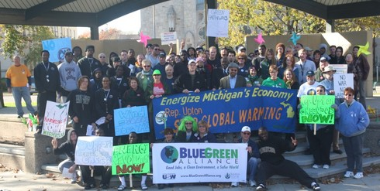
Good Jobs, Clean Environment, Green Economy

Slide 3
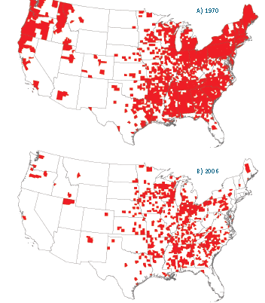
Counties with at least 50% of employment in the manufacturing sector in 1970 and 2006
Notes:
Bureau of Economic Analysis, America2050

Slide 4
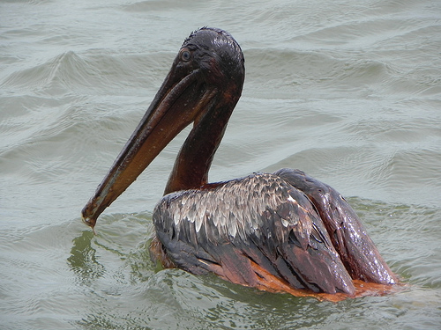
When workers are protected so is the environment
Notes:
Clean (Healthy) Environment

Slide 5
Safer, healthier, better protected workers help create safer and healthier products

Slide 6
The right to know is fundamental

Slide 7
Taking Pollution
Out of
Production
Why we need to do this: We’re getting sicker and part of the reason is chemicals

Slide 8
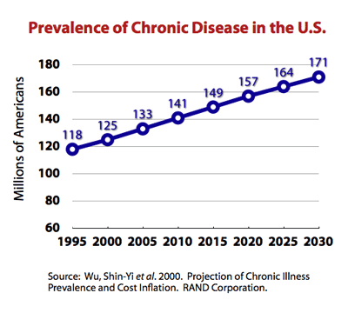
Notes:
Asthma, cancer, heart disease, diabetes, strokes, arthritis
In 2005, 133 million Americans – almost 1 out of every 2 adults – had at least one chronic illness

Slide 9
Cancer Incidence and Mortality in Children
More children are getting cancer but fewer children are dying from cancer

Slide 10
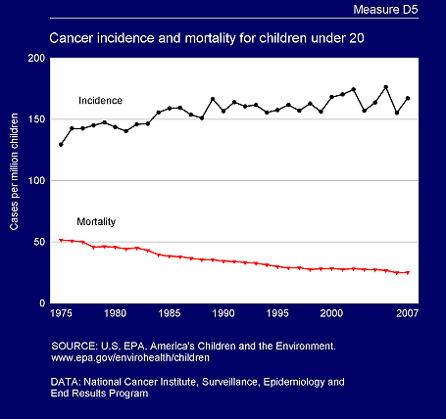
Asthma up 100% Impaired fertility up 40%
Breast Cancer up 40% Autism diagnosis up 1000%
30% more babies are being born too early

Slide 11
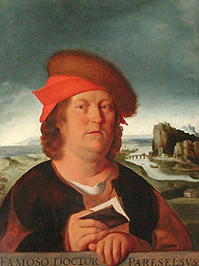
The dose makes the poison
Notes:
1493-1541

Slide 12
Why do we think this has anything to do with chemicals? Because wildlife is getting sick too

Slide 13
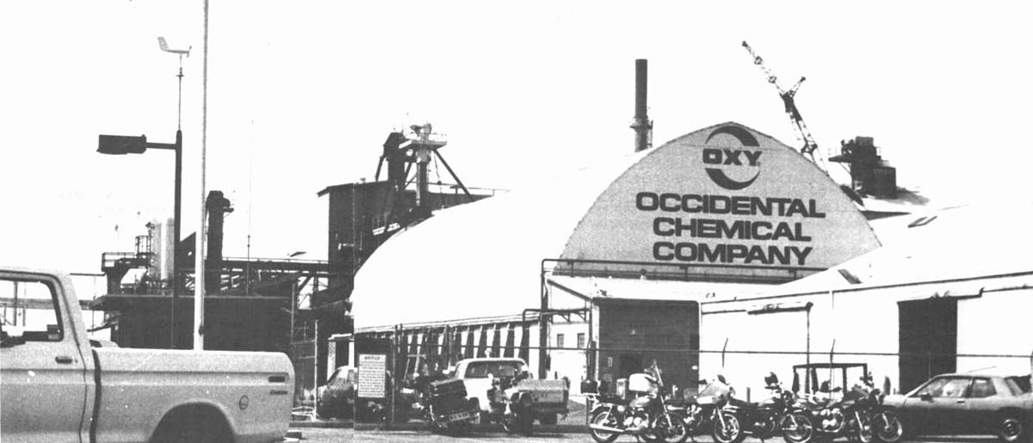
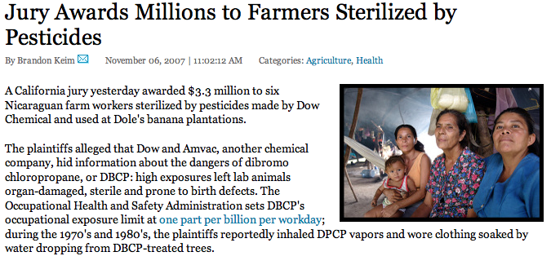
DBCP: Infertility
In the California workers who produced it and the Nicaraguan farmworkers who used it
Notes:
Dibromochloropropane In 1977 Lathrop, California pesticide manufacturing plant workers sub or infertile. Wives had higher rate of miscarriage and had more female infants than normal. Twenty years later, Nicaraguan farm workers who applied the pesticide were compensated for being made sterile by the chemical

Slide 14
Agent Orange: What We Learned From an Uncontrolled Experiment on American Soldiers and the People of Southeast Asia

Slide 15
Hodgkin’s Disease, non Hodgkin’s lymphoma, Prostate Cancer, Chronic B-cell Leukemia, Respiratory Cancers, Type 2 Diabetes, Ischemic Heart Disease, Parkinson’s Disease

Slide 16
Breast Cancer and DDT

Slide 17
Why Timing Can Matter More than Dose

Slide 18
Biomonitoring: Measuring Chemicals in People

Slide 19
CDC reports that Bisphenol A (BPA)
is in more than 90% of the American people
and Perchlorate
is in all of us

Slide 20
From the CDC’s 2009 Fourth National Report on Human Exposure to Environmental Chemicals

Slide 21
I didn’t know that the dose is only one part of the problem: there are also low dose effects, mixtures, synergies, timing, sensitivities and long delays between exposure and visible effects including multigenerational effects.
Notes:
http://www.istas.net/risctox/en/dn_risctox_ficha_sustancia.asp?id_sustancia=958773

Slide 22
Taking Pollution
Out of
Production
New science should mean new laws and policies
But if Congress won’t act, we need to do it ourselves

Slide 23
Our occupational safety and health and chemical management laws lost in the 1970s

Slide 24
Current OSHA Penalties | Are Too Low
Average serious OSHA violation | $ 965
Average penalty for violating COBRA health insurance law | $ 33,917
Maximum penalty for a serious OSHA violation | $ 7,000
Maximum penalty for violating the South Pacific Tuna Act | $ 350,000
Notes:
The maximum fine for a serious violation is $7,000 — a small fraction of those imposed by other federal agencies. By comparison, the top penalty for violating the South Pacific Tuna Act is $350,000.

Slide 25
The Toxic Substances Control Act (TSCA)
80,000 different chemicals have been produced and used since TSCA became law in 1976.
62,000 of these chemicals were grandfathered in when TSCA became law with no requirement that they be tested and shown to be safe.
In the 36 years that TSCA has been the federal law on chemicals, EPA has required testing on just 200 chemicals.
When EPA was prevented from using TSCA to restrict asbestos 21 years ago, it gave up trying.

Slide 26
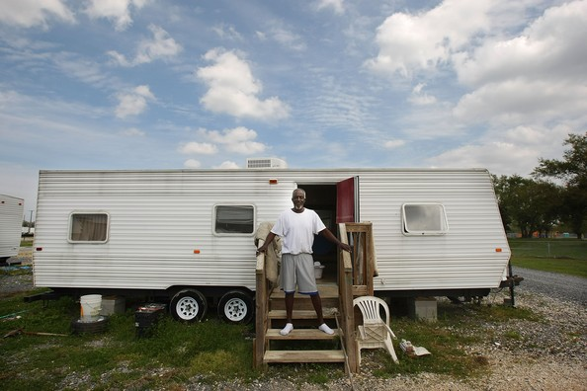

Slide 27
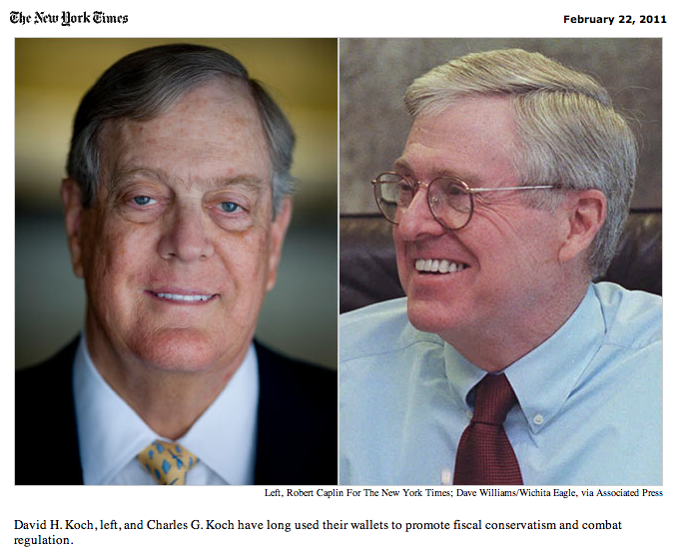

Slide 28
Toxics Legislation Passed 2003 – 2011
WA
MT
VT
M
MT
ND
E
OR
MN
NH
CA
ID
SD
WI
M
NY
MA
WY
I
RI
CA
NV
IA
PA
NJ
CT
NE
OH
DE
UT
IL
IN
CO
KS
MO
WV
VA
MD
KY
TN
NC
AZ
NM
OK
AR
SC
AK
MS
AL
GA
TX
L
AK
A
F
Shaded = SAFER state
L
HI
81 chemical safety laws adopted 2003-2011 in 18 states encompassing 41% of US population
* Eleven Republican and Seventeen Democratic Governors signed bills
* Bills passed with support from over 3/4 of Republican legislators (76%), and nearly all Democrats (99%)
Notes:
In the absence of federal action, states are stepping up…
81 chemical safety laws were adopted between 2003 and 2011 in 18 states encompassing 41% of the U.S. population. Not including Mercury
99% of D’s and 86% of R’s supported passed policy. Signed by R and D Governors. Through R controlled chambers.
The pace is increasing – in 2003 only 2 laws passed in 2011…
34 states have mercury policy AR, CA, CT, DE, FL, GA, IL, IN, IA, LA, ME, MD, MA, MI, MN, MO, MT, NE, NH, NJ, NM, NY, NC, OH, OR, PA, RI, SC, TN, UT, VT, VA, WA, WI)

Slide 30
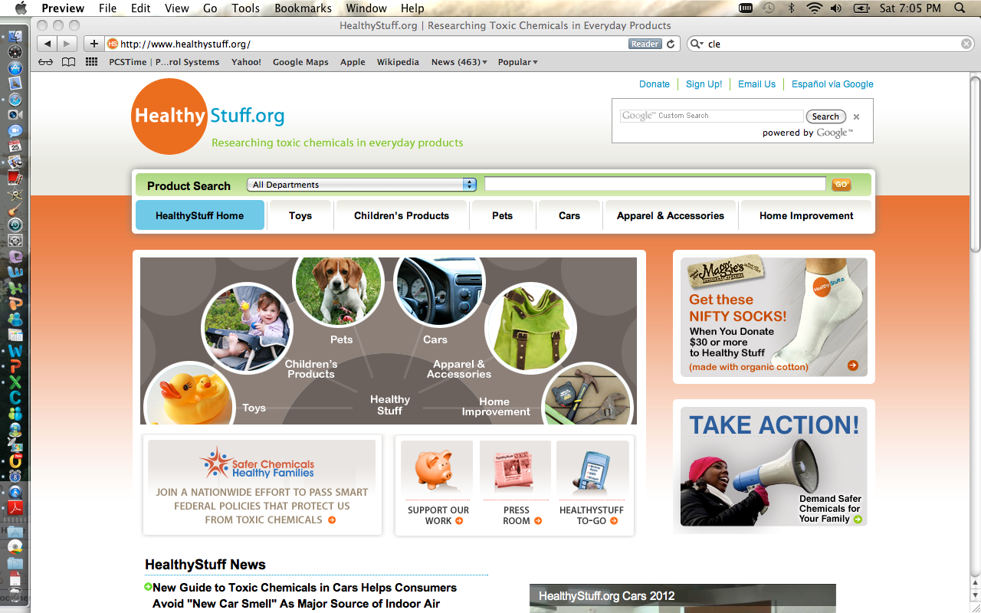

Slide 31
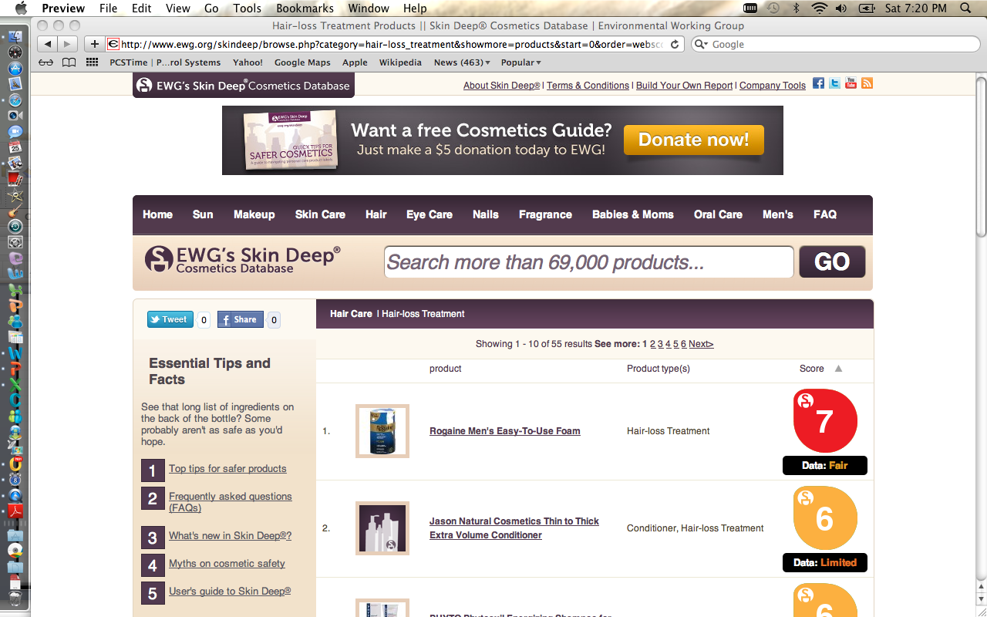

Slide 32
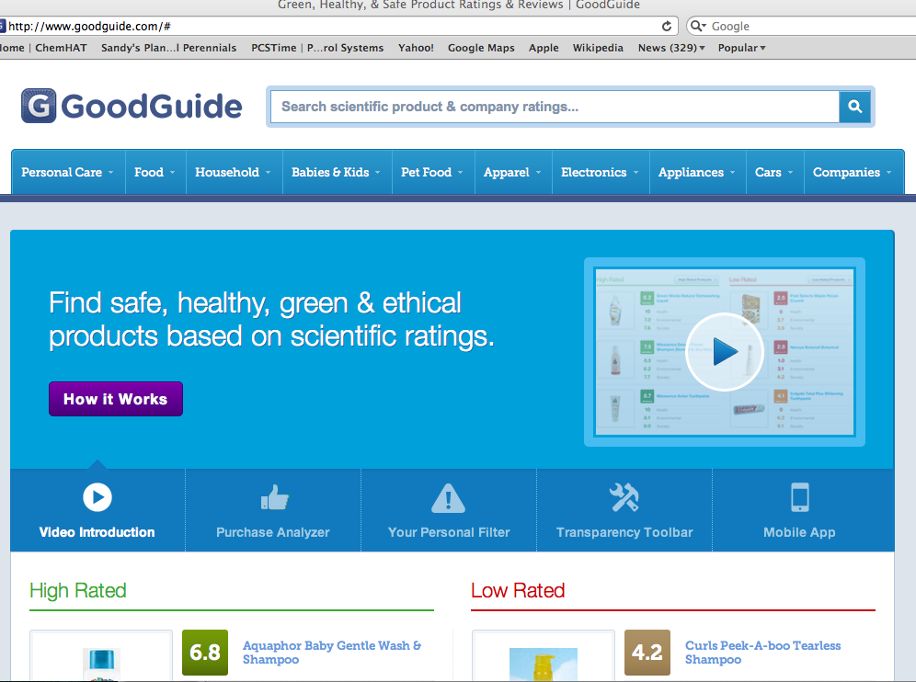

Slide 33
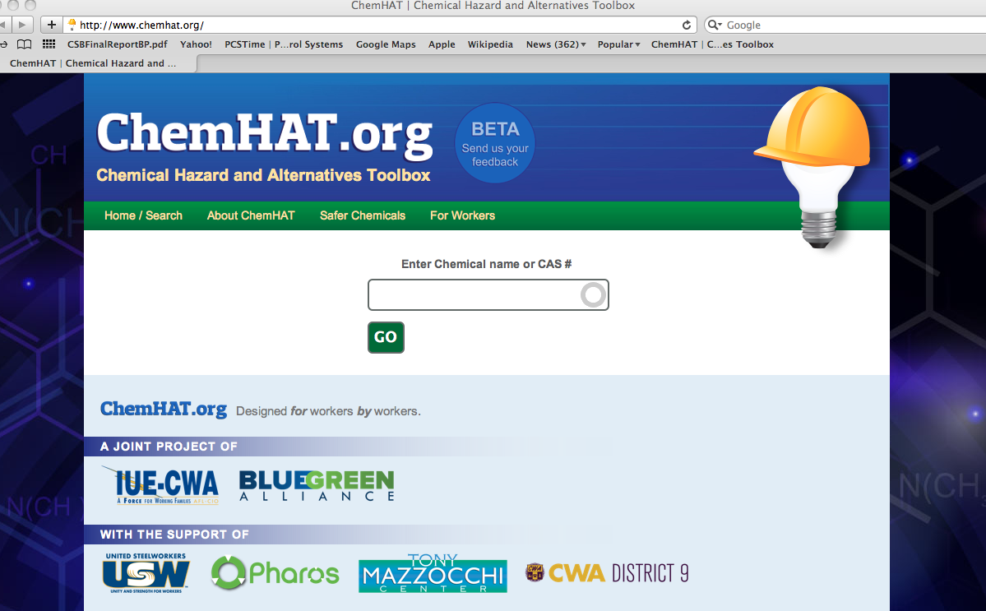
ChemHAT
Taking Pollution
Out of
Production
How it Got Here: How do workers find chemical information?

Slide 34
Ethylene Oxide

Slide 35
Notes:
Is a carcinogen and is also linked to spontaneous abortion and genetic damage

Slide 36
http://hazmap.nlm.nih.gov/cgi-bin/hazmap_generic?tbl=TblAgents&id=21

Slide 37
http://toxtown.nlm.nih.gov/text_version/chemicals.php?id=71

Slide 38
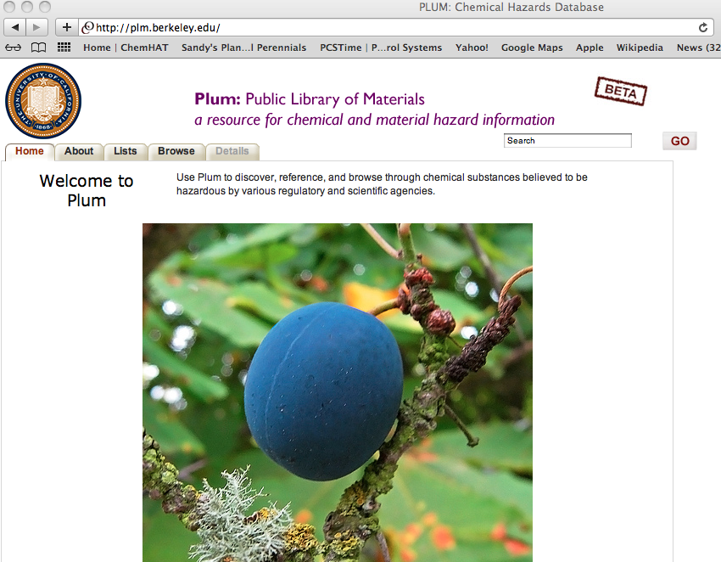

Slide 40
Your health and safety committee has decided to convince your company to switch from using a dangerous chemical to a safer alternative.
What information would you need to help you get your employer switch to a safer chemical?

Slide 42
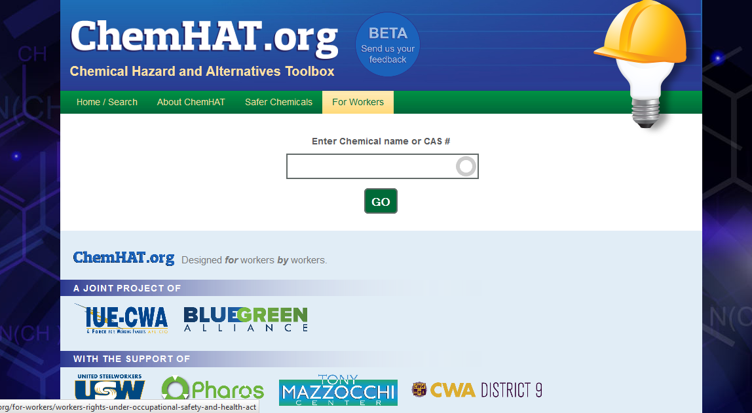

Slide 43
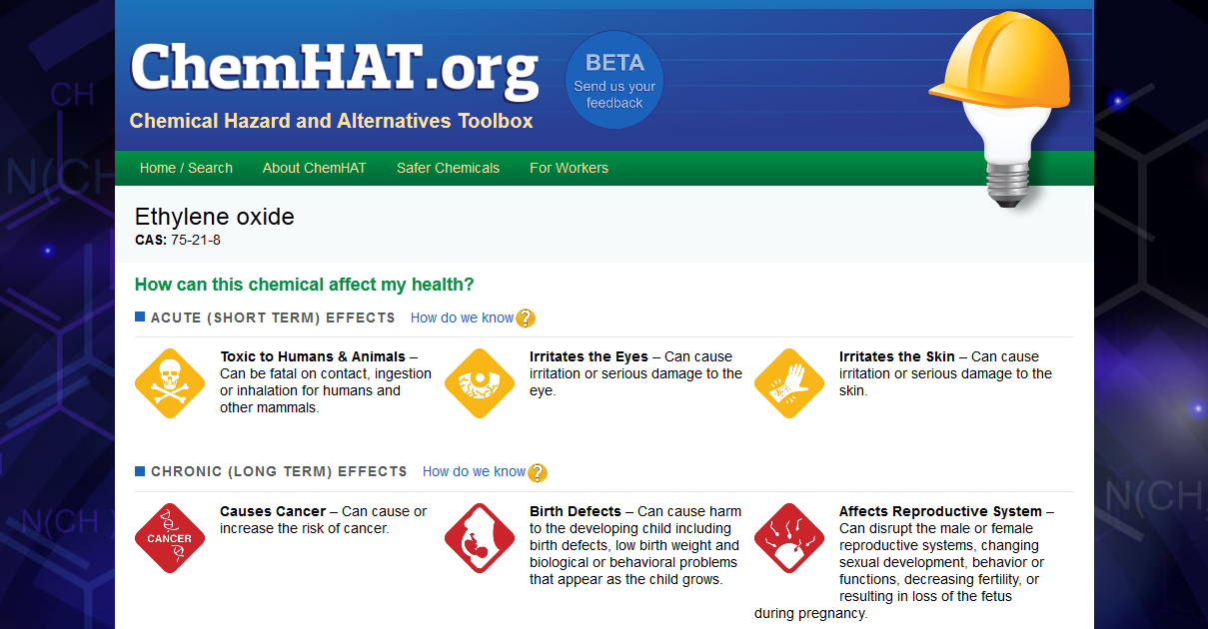
Notes:
Need new screenshot here with “How do we know?”

Slide 45
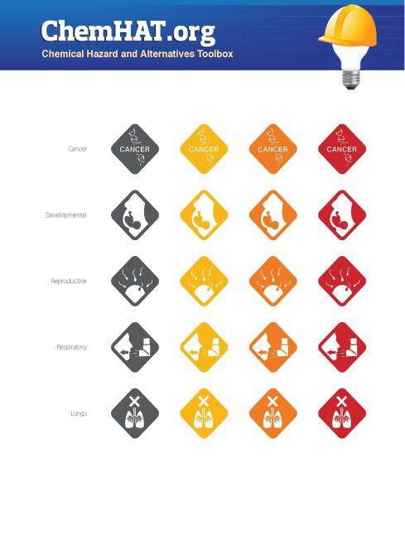
Notes:
Endpoint descriptors for each impact; color represents strength of impact, plus strength of data

Slide 46
ChemHAT vs. GHS Icons
Notes:
Wanted more specificity on the health endpoints

Slide 47
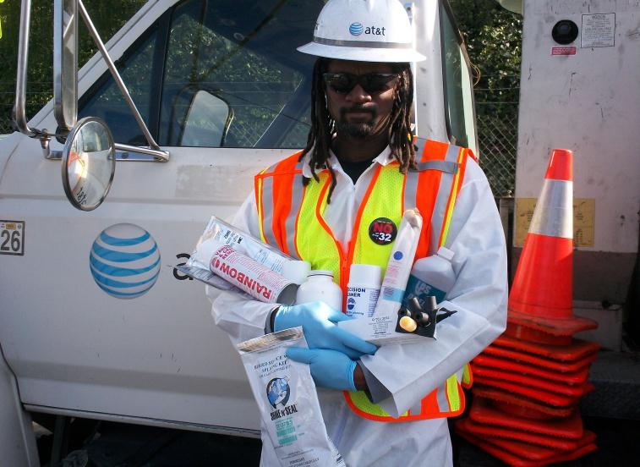

Slide 51
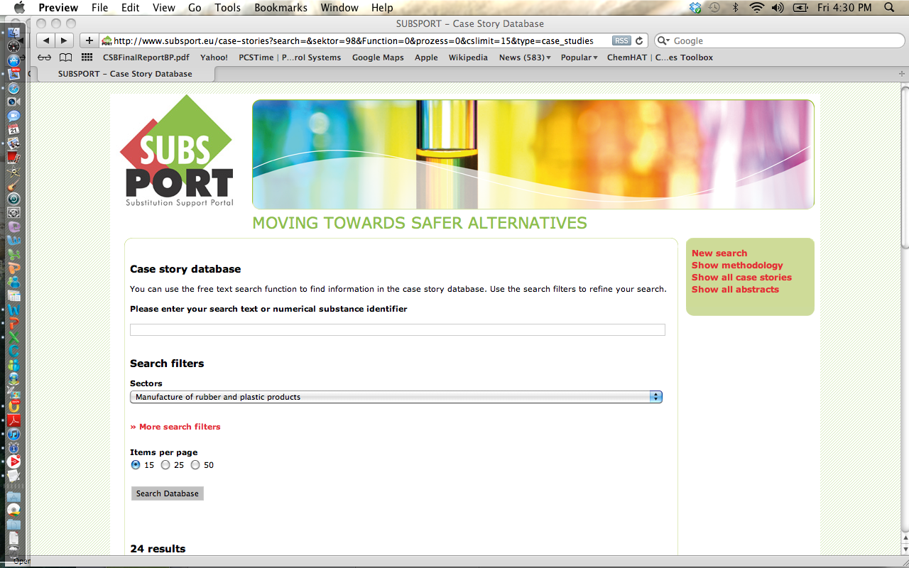

Slide 52
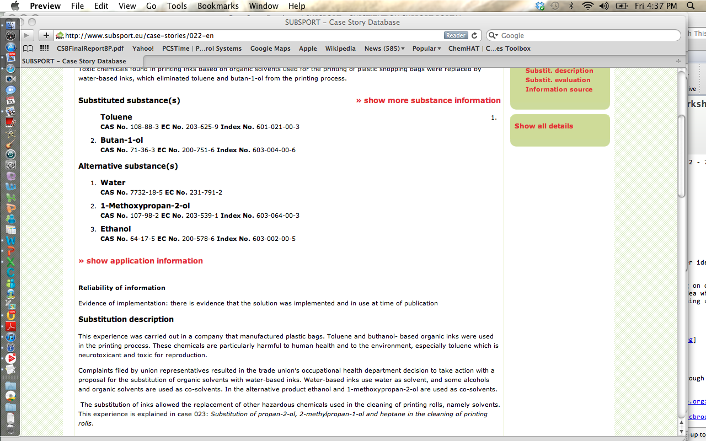

Slide 53
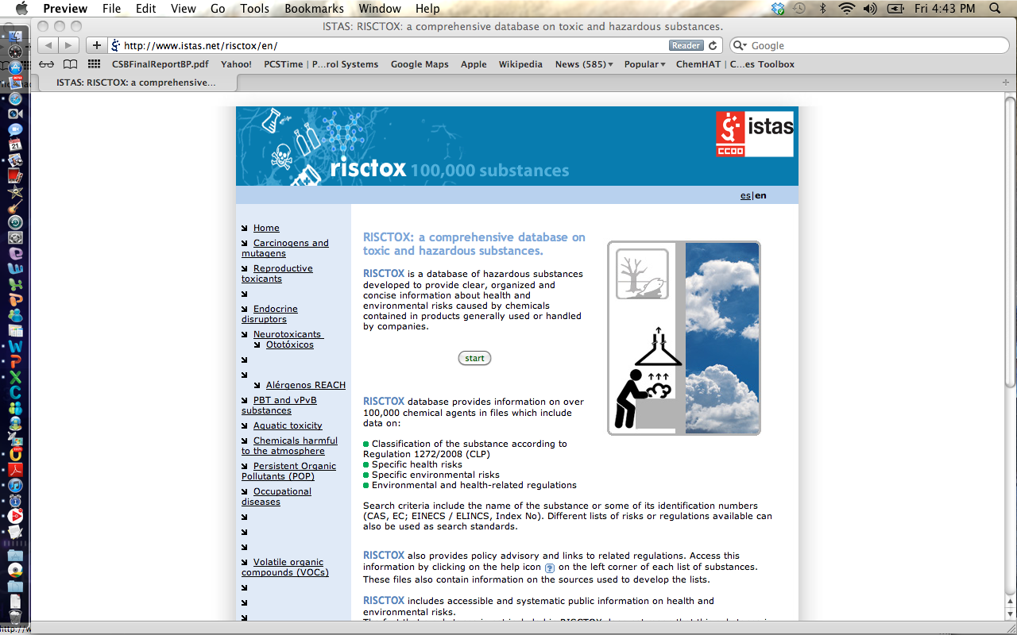

Slide 54
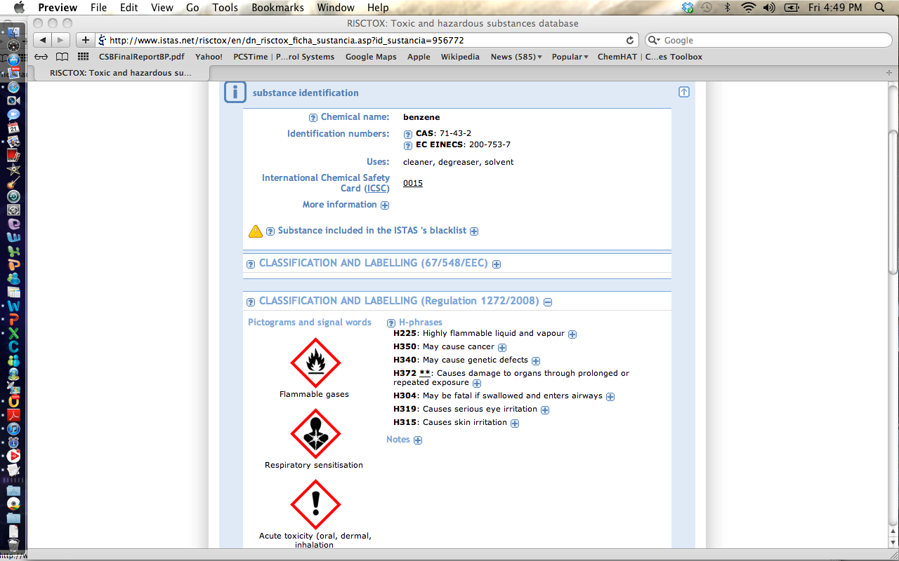

Slide 55
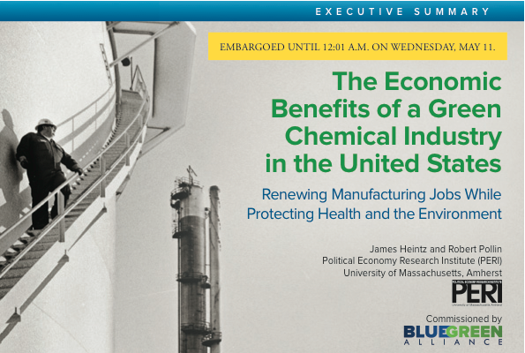
The Economic Benefits of a Green Chemical Industry: Renewing Manufacturing Jobs While Protecting Health and the Environment
=
Notes:
Thank you.

Slide 56
The U.S. Chemical Industry Today
The chemical industry is an important part of U.S. manufacturing, contributing $273 billion to GDP ($390 billion if we include the plastics sector).
But employment in the chemical industry has been declining sharply over the past few decades, despite the fact that the value of production has been growing 4% per year.

Slide 59
Greener Chemistry & Regulatory Reform Supports Competitiveness
Lowering handling, storage, and disposal costs
Ensuring access to global markets
Reducing waste by using inputs more efficiently
Moving away from fossil fuel based inputs
Meeting consumer demands for safer products
Protecting shareholder value

Slide 60
 | Decaffeinate coffee with benzene In 1970s benzene replaced with dichloromethane | Decaffeinate coffee with water or carbon dioxide
 | Manufacture IV bags and tubes using polyvinyl choride and DEHP | Switch production to lighter, stronger polypropylene plastic that do not contain chemicals of concern and does not need a moisture overwrap
 | Produce glass for electronics using arsenic to remove air bubbles | Maintain liquid glass at higher temperature for longer periods

Slide 61
What product needs to be redesigned to make your life less toxic?

Slide 62
Thank you.
Charlotte Brody, Associate Director for Health Initiatives
BlueGreen Alliance, cbrody@bluegreenalliance.org
www.bluegreenalliance.org www.chemhat.org

